Slide 1
Systems Analysis and Design Concepts
COMP 2615
Exercise 2 – System Development
Frank Wegener
Jean-Philippe Aubin – A00683569 Sean Earhard – A00024208 Giselle Larcombe – A00693783 Chi Turner – A00027941

Slide 2

1. Scope Definition
Project Background
The four members of Group Four don't have enough money to buy a vacation home. By pooling our money together, we will have enough money to buy land and build a home.
Project Sponsor/Stakeholders
Giselle, 25% Shareholder
JP, 25% Shareholder
Chi, 25% Shareholder
Sean, 25% Shareholder

Slide 3

Scope
Assumptions
IN SCOPE:
Vacation home location selected
Vacation Home designed
Vacation Home constructed
Land will be available and affordable in budget
Home design can be agreed on by all parties
All parties will be able to contribute $225,000 to the budget
Construction can be completed by the project due date

Slide 4

High-Level Project Risks
Constraints
Project completion is dependant on weather cooperating with construction schedule.
Stakeholders may not agree on location or design of vacation home.
Land may not be available.
Construction crews and/or materials may not be available in project time frame.
Vacation home must be constructed by December 25, 2007.
Home must include a swimming pool.
Home construction must be environmentally friendly where possible.
Budget = $900,000

Slide 5
Critical Success Factors
Stakeholders must agree on house location and design by June 1, 2007
Construction must begin before September 15, 2007.
Completion Criteria
The following completion criteria are to be applied against this project:
Stakeholders, by majority vote upon delivery, approve the final product

Slide 6

2. Problem Analysis
Business Needs/Justification
Benefits of installing a building a vacation home:
We all live in Vancouver and would like to have a ‘home away from home’.
Would like to take weekend trips far enough away to provide a getaway from our stressful Vancouver lives but not far enough that we have to fly to get there. We have agreed to locate the home in Tofino, British Colombia
All group members enjoy surfing and would like a vacation home where we can indulge our passion for this sport.
Project Objectives
  Select a vacation home location
  Design the vacation home
  Build the vacation home before December 25th, 2007.

Slide 7
Key Milestones
30 June 2007: Purchase of suitable lot to be completed
31 July 2007: Building contractor hired
1 December 2007: House completed
25 December 2007: Christmas Party
Feasibility Checkpoint
Stakeholders have approved to the Problem Analysis and agreed to proceed

Slide 8
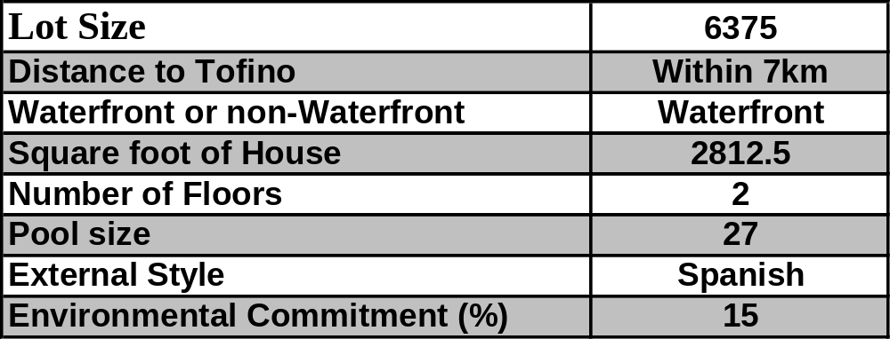
3. Requirement Analysis
BUSINESS REQUIREMENTS: By surveying the stakeholders to determine their requirements for each of the criteria outlined in the Problem Analysis, the following project requirements were established:

Slide 9

Requirement Priorities
Based upon feedback from all stakeholders it was determined that the Business Requirements would have the following priorities:
1. Distance To Tofino
2. Waterfront Lot
3. Number of Floors
4. External Style
5. Pool Size
6. Square foot of house
7. Lot size
8. Environmental Commitment

Slide 10

4. Logical Design
LOCATION:
Stakeholders have agreed to locate the home in Tofino, British Colombia.
DESIGN:
After careful consideration, the house design below was selected as it met all our criteria. A slight modification will be to install solar panels.

Slide 11
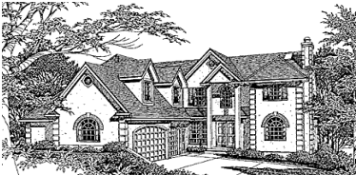
4. Logical Design Specifics
Style: Spanish/Mediterranean
Living square feet: 2921
Main floor: 1625 sq. ft.
Upper floor: 1296 sq. ft.
Bedrooms: 4 Baths: 4
Garage Style: attached Garage Bays: 3
Width: 54'0” Depth: 70'0"
Roof height: 34'8” Roof pitch: 14/12
Exterior wall framing: 2x6
Foundations: Slab, daylight basement
Additional feature: Solar panels

Slide 12
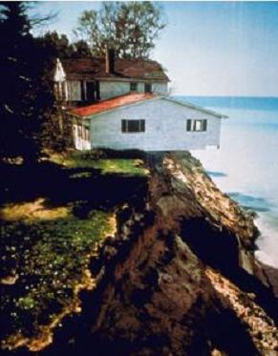
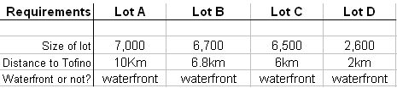
5a. Decision Analysis - Lot
Identify candidate technical solutions
The 4 following lots have been identified as candidate solutions:

Slide 13
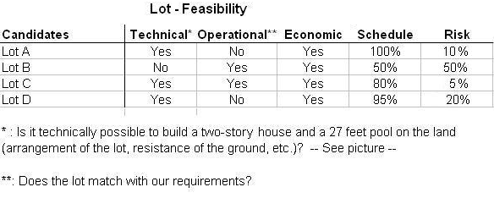
5a. Decision Analysis - Lot
Analyze candidate technical solutions for feasibility

Slide 14

5a. Decision Analysis - Lot
Recommend a candidate system
The most feasible candidate solution is: Lot C

Slide 15
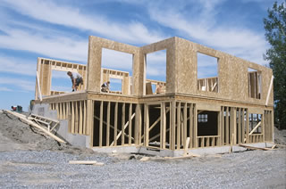
5b. Decision Analysis - House
Identify candidate technical solutions
Stakeholders have identified a total of 6 candidate solutions, as follows:
House already built Local Architect Pre-built house Stock Home Plan Cie. Nice Homes Cie. Ourselves!

Slide 16
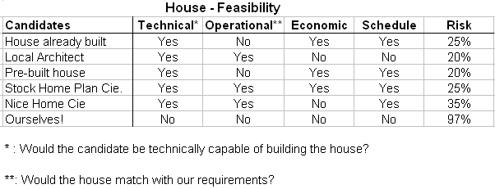
5b. Decision Analysis - House
Analyze candidate technical solutions for feasibility

Slide 17
5b. Decision Analysis - House
Recommend a candidate system
The most feasible Candidate Solution is:
Stock Home Plan
SYSTEM PROPOSAL: After careful Analysis, LOT C will be purchased and the company Stock Home Plan will build the house, since they offer the most feasible solution.

Slide 18
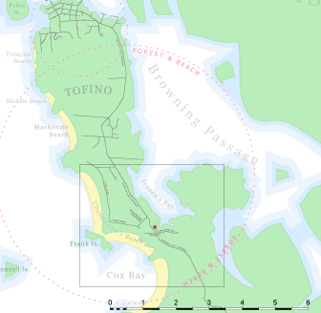
6. Physical Design & Integration
Distance to Tofino:
Within 7km

Slide 19
Physical Design & Integration
Waterfront
Lot C:
902 Jensen’s Bay Road
Tofino BC V0R 2Z0

Slide 20
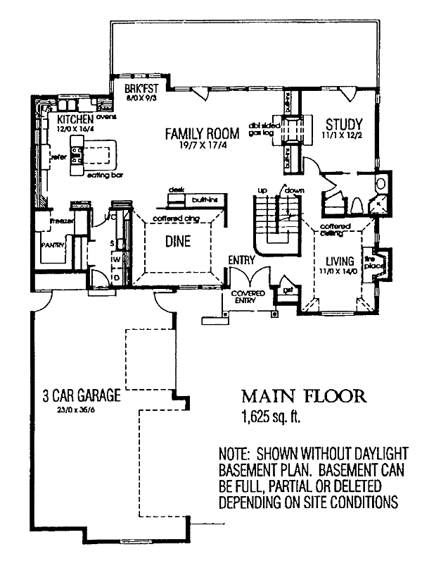
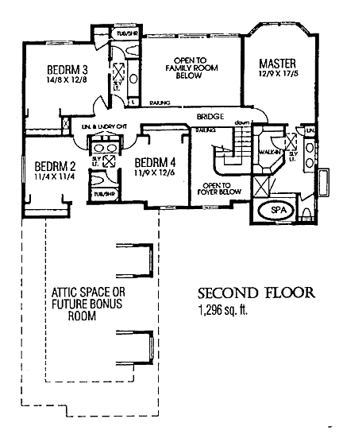
Physical Design & Integration
Number of Floors: 2
External Style:
Spanish

Slide 21
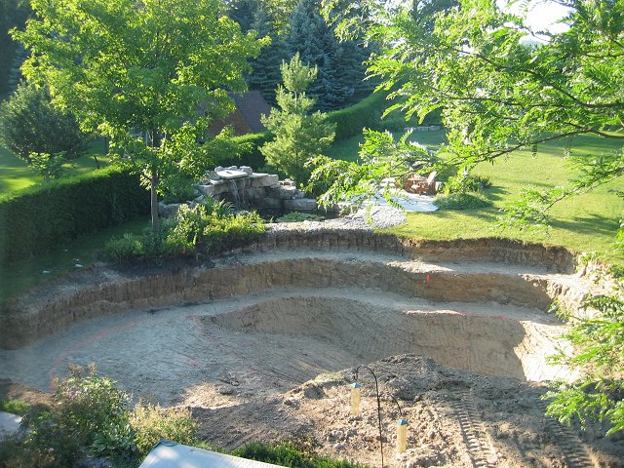
Physical Design & Integration
Pool
Negotiate a quote with Surfside Leisurescape Inc. for 27’x20’ swimming pool, including interlocking deck & chain-link fence. Initial digging completed by previous owners.

Slide 22
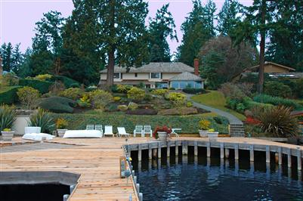
Physical Design & Integration
Square footage of House: 2312.5 (2 levels) – see slide #20 for layout

Slide 23
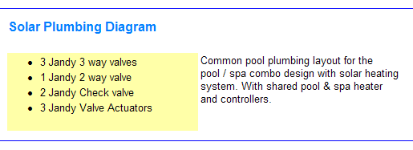
Physical Design & Integration
Environmental Commitment
Receiving quotes from the following companies:
Jandy Pool Products, Inc.

Slide 24
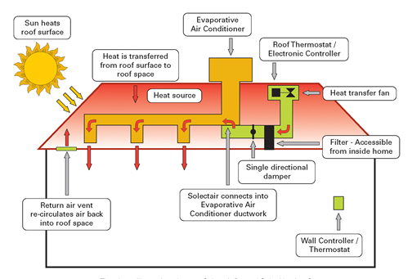
Physical Design & Integration
Solectair Inc.
Solar Ducted Heating System (installed as part of evaporative air conditioning system)

Slide 25

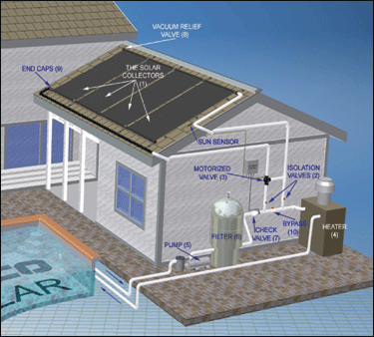
Physical Design & Integration
Kyocera, Solar Inc.
“MyGen Utility Interactive System” (for clean electricity; independence from oil & gas)

Slide 26
7. Construction & Testing
For this project, the primary purpose of the construction and testing phase was to build and test (or have inspected) a house that fulfills business requirements and physical design specifications as stated in sections 3 and 6.
Following is the timeline of every step in the Construction and Testing phase including approval checkpoints (either by the stakeholders or by City Hall):

Slide 27
Construction & Testing
Date | Action
June 1 | Purchase of lot completed
June 20 | Building permit obtained
June 22 | Potential contractors contacted
July 9 | Building contractor hired and agreed that contractor will be in charge of entire project, including heating & plumbing and electrical installation
Sept. 5 | Construction begins!
Oct.3 | Heating & plumbing inspected by City Hall and electrical inspected by the provincial inspector
Oct.4 | Framing inspection by City hall
Oct. 30 | Confirmation that inspections satisfactory and building has been completed. All stakeholders are very satisfied with the building
Nov. 6 | Landscaping begun and pool installed
Nov. 12 | Insulation inspected by city hall, drywall started
Nov. 26 | Painting completed. Wow, nice job!
Dec. 3 | Kitchen and bathroom fixtures installed. Approved!
Dec. 10 | Cabinets installed and lighting completed. Approved!
Dec. 17 | Carpets have been laid, and the appliances have been installed. The furniture has been delivered
Dec. 19 | Final inspection done by city hall and occupancy permit received!
Dec. 23 | The 4 of us arrive at the house to collect our keys and to complete any last-minute tasks, ensure the house is clean and to buy food and drinks in preparation for Christmas Dinner
Dec. 25 | Christmas Dinner – the party is a success!

Slide 28

8. Installation and Delivery
USER TRAINING
INSTALLATION PROBLEM ANALYSIS
On December 23 all stakeholders will receive keys to the house along with a walkthrough by the general contractor that will include a full tour of the house.
During the December 23 meeting all stakeholders will have the opportunity to raise issues that may require rework of the house. Rework and budget will be authorized at that time.

Slide 29

Installation and Delivery
USER MANUALS
POST-INSTALLATION REVIEW
During the delivery meeting the general contractor will present to the stakeholders all manuals for appliances located within the house. A list of house rules and emergency procedures will be posted on the refrigerator.
On January 15th all stakeholders will participate in a conference call to discuss the project and outline changes to procedure that need to be implementeds during future projects

Slide 30
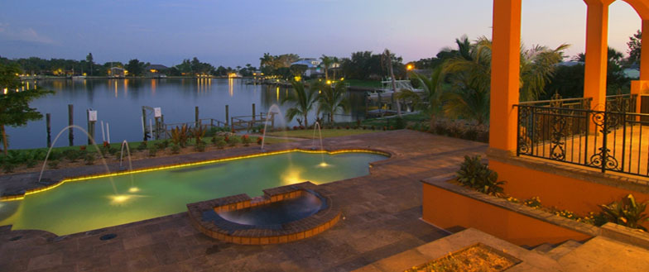
End of Presentation

